Slide 1
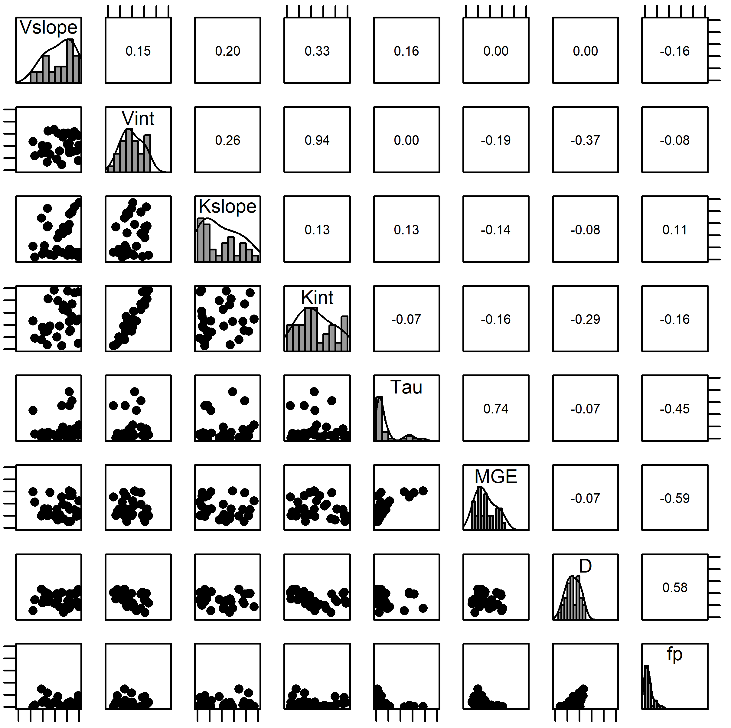
0
1
0
1
0
1
0
1
0
1
0
1
0
1
0
1
0
1
0
1
0
1
0
1
*
0
1
0
1
0
1
0
1

